Slide 1
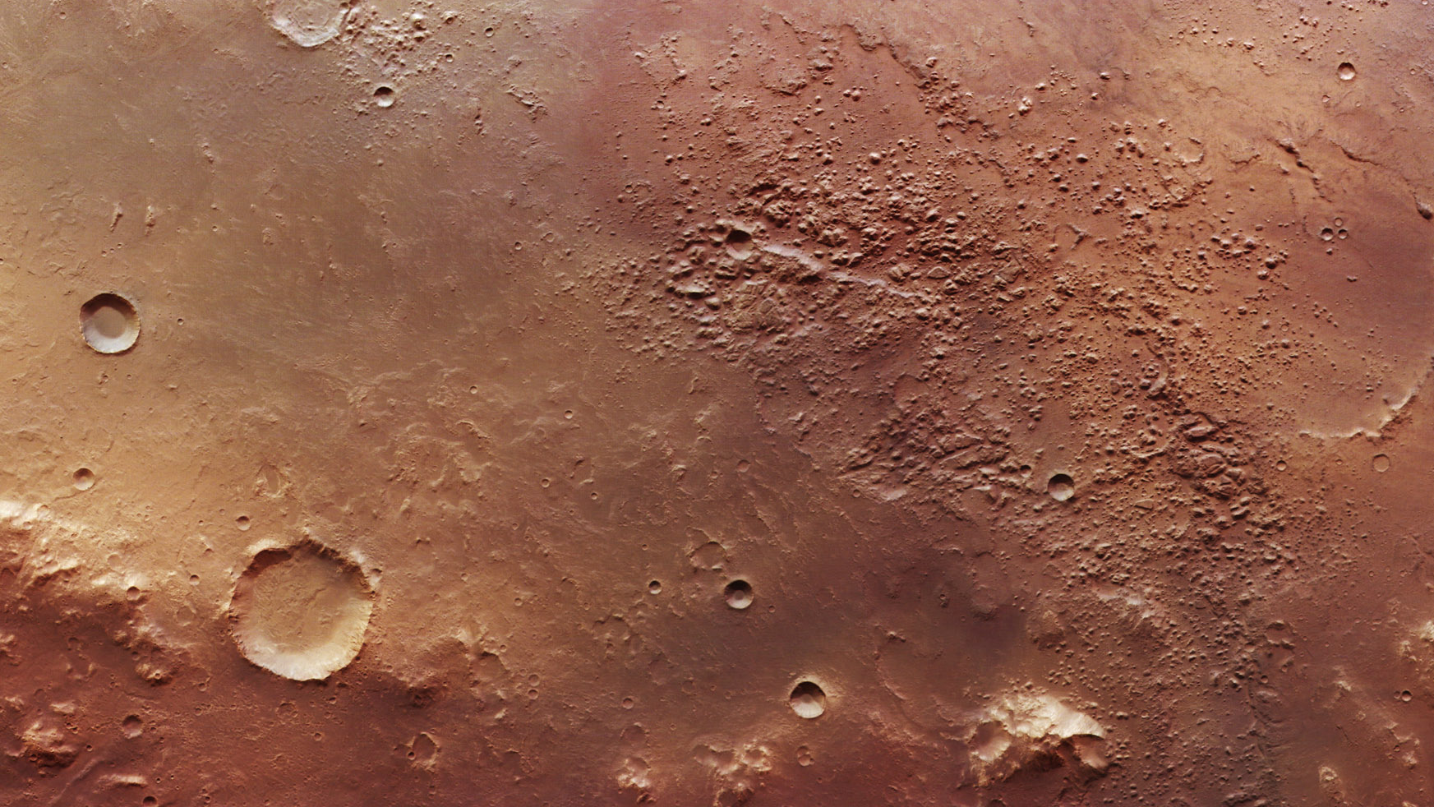

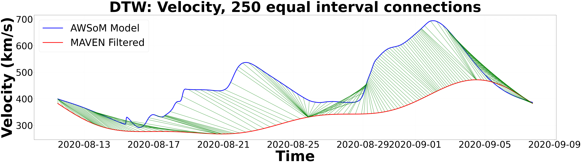
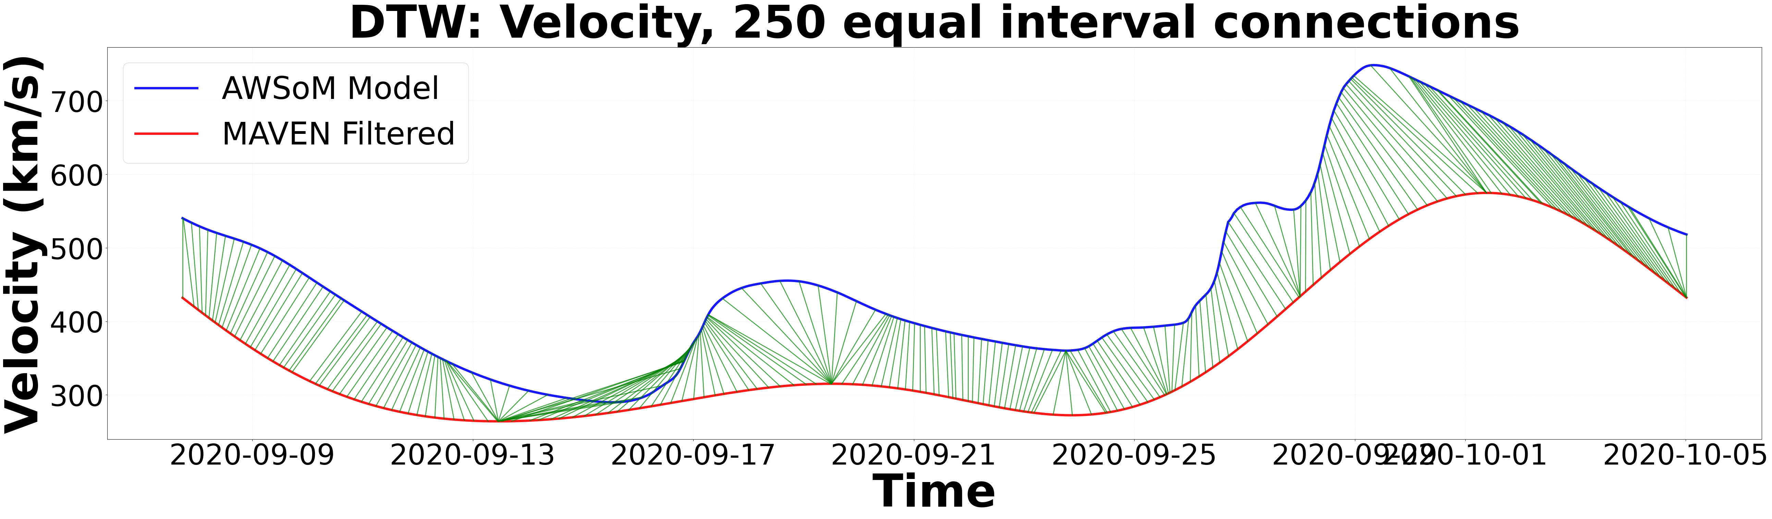
Modelling of upstream Solar Wind and IMF conditions at Mars: A Data-Model comparison between MAVEN and the SWMF AWSoM model
Priscilla Tay
Current State of Validation/Assessment of Models
The Space Weather community’s great emphasis on traditional point-by-point metrics
Insufficient assumption that observations and predictions are always already temporally aligned
We also need to account for time offsets and find the right balance of metrics
To our knowledge, only one known validation metric: Dynamic Time Warping (DTW)
CR2234 Velocity (km/s) Time Warping Connections
CR2235 Velocity (km/s) Time Warping Connections

